Slide 1
Research Presentation
A Large-Scale Audio UAV Dataset and
An Audio-Based UAV Classification System Using CNN
Y. Mia Wang
NMU, February 1st, 2023

Slide 2
Publications
Kim, Juann, Dongwhan Lee, Youngseo Kim, Heeyeon Shin, Yeeun Heo, Yaqin Wang, and Eric T. Matson. Deep Learning Based Malicious Drone Detection Using Acoustic and Image Data. No. 9335. EasyChair, 2022.
Wang, Yaqin, Zhiwei Chu, Ilmun Ku, E. Cho Smit, and Eric T. Matson. "A Large Scale Uav Audio Dataset and Audio-based Uav Classification Using Cnn." Accepted to publish in 2022 Sixth IEEE International Conference on Robotic Computing (IRC).
Wang, Yaqin, Facundo Esquivel Fagian, Kar Ee Ho, and Eric T. Matson. "A Feature Engineering Focused System for Acoustic UAV Detection." In 2021 Fifth IEEE International Conference on Robotic Computing (IRC), pp. 125-130. IEEE, 2021.
Wang, Yaqin, Facundo Esquivel Fagiani, Kar Ee Ho, and Eric T. Matson. "A Feature Engineering Focused System for Acoustic UAV Payload Detection." In ICAART (3), pp. 470-475. 2022.
Wang, Yaqin, Jin Wei-Kocsis, John A. Springer, and Eric T. Matson. "Deep Learning in Audio Classification." In International Conference on Information and Software Technologies, pp. 64-77. Springer, Cham, 2022.
Notes:
Unmanned Aerial Vehicles (UAVs) have seen an exponential increase in popularity in recent years [1]. As the technology evolves, drones have become cheaper and smaller, which allows a wide range of new applications, from amateur sporting events to homeland security, but the increased accessibility to these devices also poses a threat.

Slide 3
Agenda
Introduction
Methodology
Current Experiments and Results
Conclusion and Future Works

Slide 4
Introduction

Slide 5
M2M Lab
Counter-UAV projects
IOT projects
Robotics and autonomous driving projects
And more

Slide 6
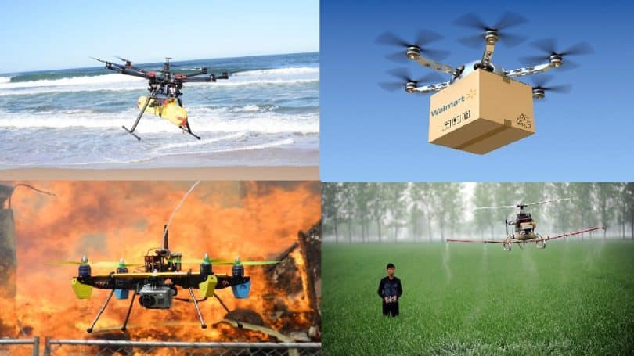
Problem
Notes:
The use of Unmanned Aerial Vehicles (UAVs) has been an exponential increase in popularity in personal and commercial, and even military recent years [1]. As the technology evolves, drones have become cheaper and smaller, which allows a wide range of new applications, from amateur sporting events to homeland security, but the increased accessibility to these devices also poses a threat.

Slide 7
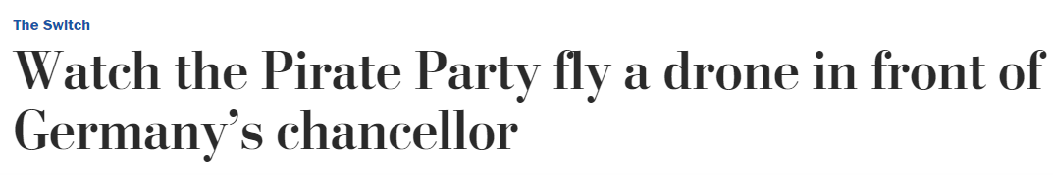
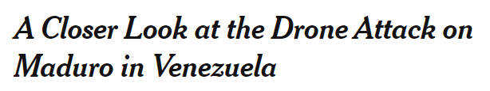

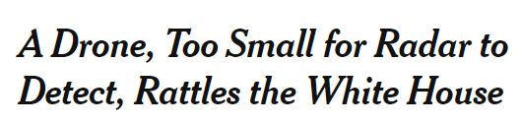
Problem
Notes:
Smaller UAVs allow them to invade restricted zones without being detected, and to carry potentially harmful payloads, such as weapons and explosives. Alarming examples of UAV threats can be cited, such as the case of a drone landing inside the perimeter of the U.S. White House in 2015 [2], or the attacks to German chancellor Angela Merkel in 2013 [3] and Venezuelan president Nicolás Maduro in 2018.

Slide 8
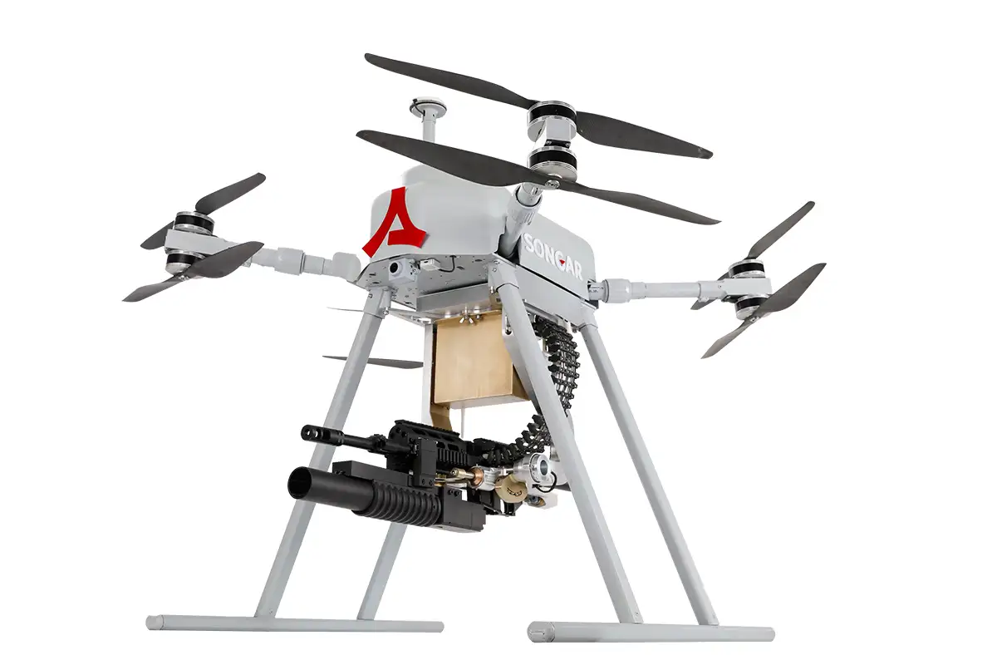
Problem
Malicious Drone Attack and Threat
Notes:
Drones may carry explosive item or weapons.

Slide 9
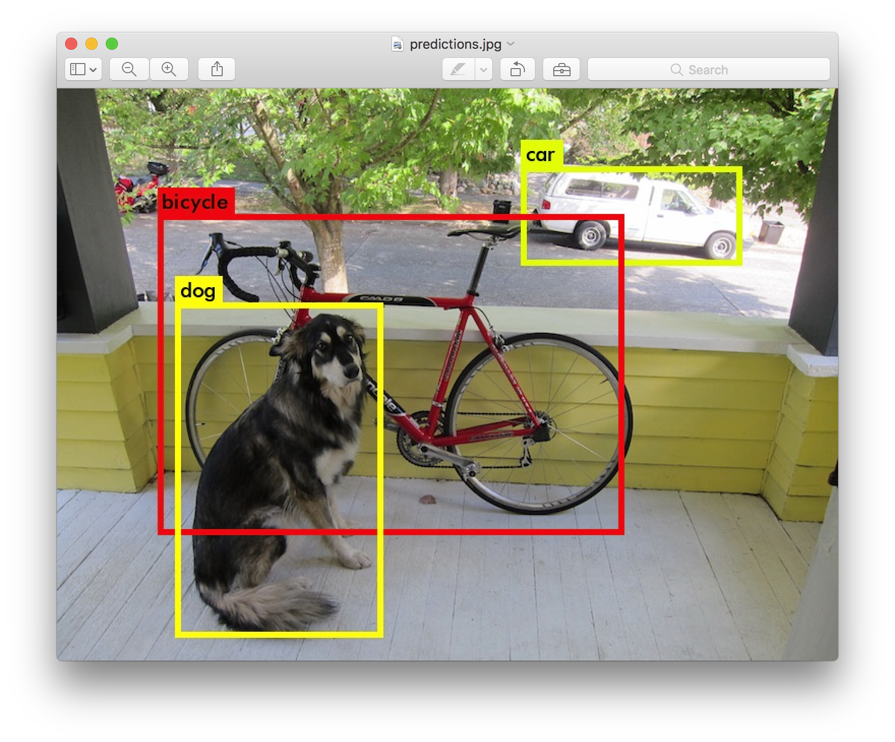
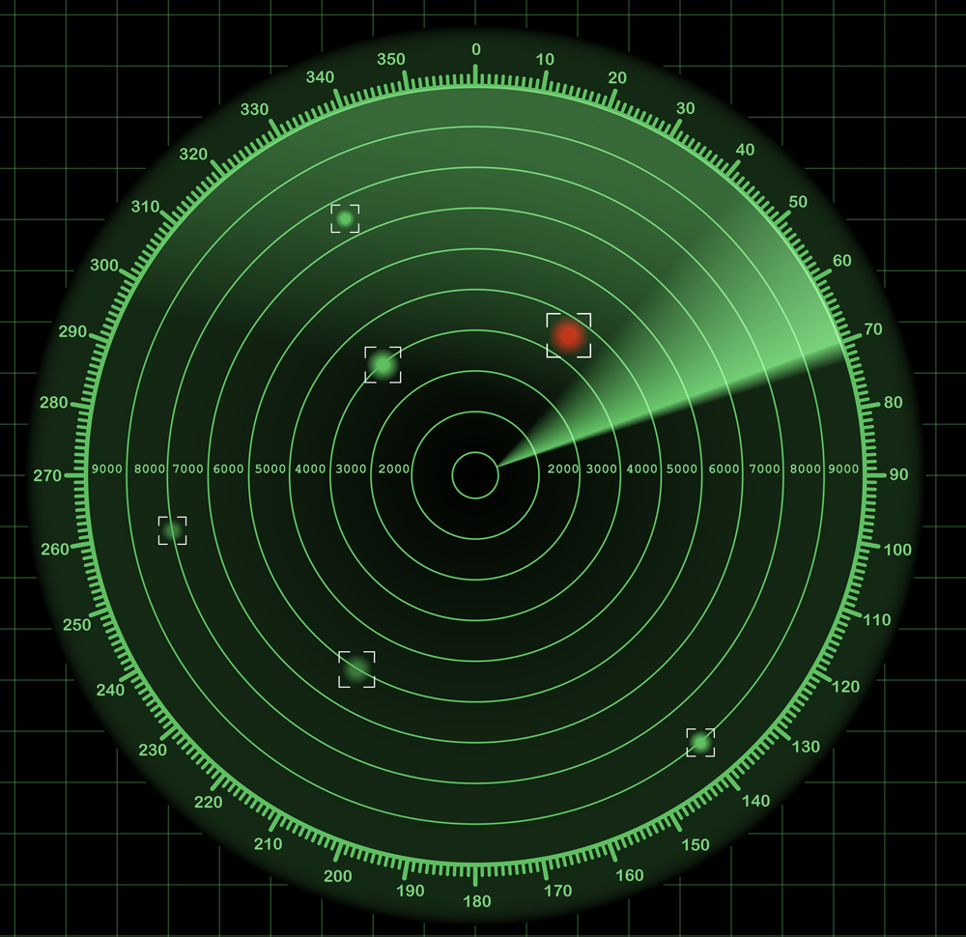
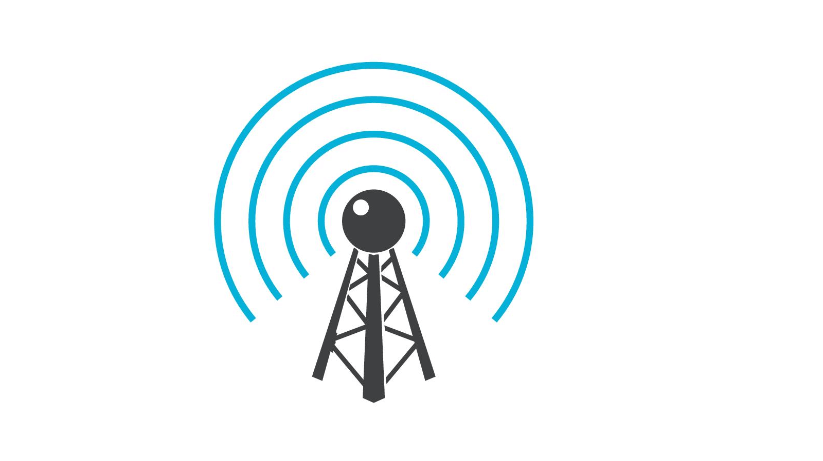

Possible Solutions
Visual
Radar
Radio
Audio
Notes:
The risk that malicious UAVs represent has motivated multiple studies on the detection of these devices. Visual, radar, radio-frequency, and acoustic solutions have been addressed, some of them with promising results, but each approach has its own limitations.
Visual recognition approaches find troubles when the visibility is blocked or reduced by environmental factors (i.e. light, smoke, crowds, etc.).
Radar recognition devices find it difficult to identify objects with small radar cross section (RCS).
Radio-frequency technology is not able to spot UAVs that work autonomously because they do not emit identifiable frequencies.
Finally, sound recognition devices are limited by environmental noise [5].

Slide 10
Why Sound?
Why Audio
Cost-effective
High accuracy
Every drone sounds different

Slide 11
Research Questions/goals
Collect a large-scale UAV dataset for detection and classification purpose
Evaluate and validate the dataset
Develop a UAV classifier using CNN
Evaluate and test the classifier

Slide 12
Methodology

Slide 13
Overall System
Notes:
Figure here presents the overall process for the proposed UAV audio classification system.
Firstly, the audio data is recorded and labelled with UAV manufacture, model, and the data/time information.
Then, feature extraction is performed to obtain MFCCs from an audio sample, firstly, audio file is converted from Hertz to Mel scale. Secondly, we calculate the logarithm of the Mel representation of audio, followed by taking logarithmic magnitude and applying discrete cosine transformation. From above steps, a cepstrum feature created from Mel frequencies is the MFCC feature.
The next step is to evaluate and verify the dataset by training different machine learning models, including Gradient Boosting, KNN, Decision Tree, Random Forest, and Gaussian Naive Bayes. After evaluating the dataset, the extracted features then are used to feed into the CNN model to train an UAV classification system.
After the training, an evaluation is performed to test how the system reacts to the data it never saw before. Lastly, the model is assessed with accuracy and loss in training and testing, and confusion matrix.

Slide 14
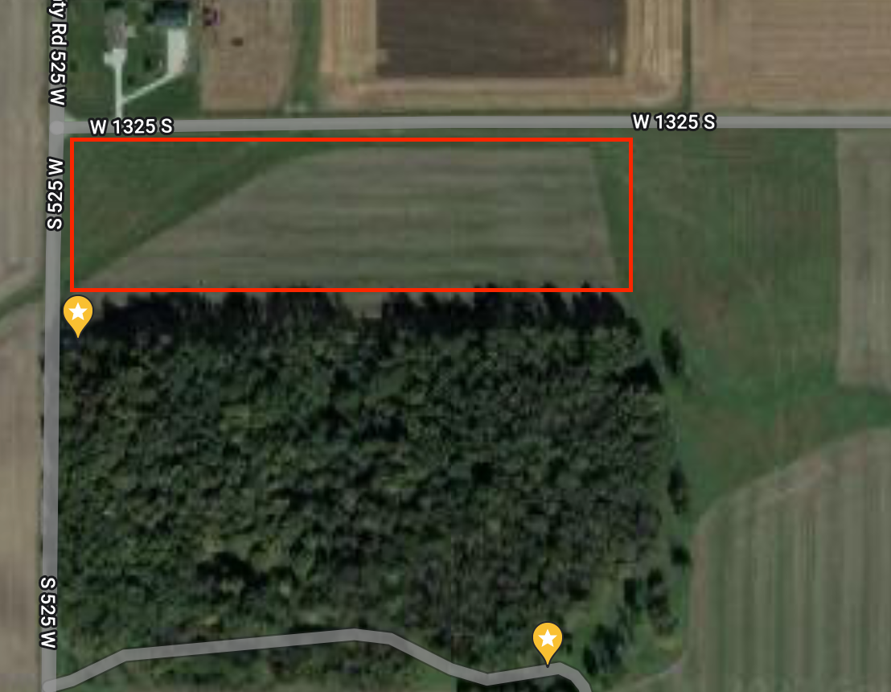
Data Collection
Outdoor Data Collection
New Richmond, Indiana, (40.2227062, -87.0000169)
Indoor Data Collection
K-SW, Purdue University
Notes:
I am trying to fly and collect audio data from at least 20 different UAVs. For each UAV, at least 100 audio entries are recorded and each containing 5 seconds of recording of the flying drone audio data.
The manufacturers of the UAVs include most of the DJI, Autel, Syma, Yuneec, and self-build ones. I operate and record UAVs by DJI, Autel Robotics, Yuneec, and self-built ones in the outdoor environment. All the UAVs by Syma , and some of DJI ones in the indoor environment. Syma UAVs could not withstand well outdoors and usually drifted away in the wind.
Figure here shows the estimate area that most of the outdoor data collection takes place. Most of the outdoor operation of drones took place in an open area in New Richmond, Indiana, and the coordinate is (40.2227062, -87.0000169). The indoor recordings took place in K-SW at Purdue University.

Slide 15
Audio Feature Extraction
Feature | Shape
chroma_stft | 12
chroma_cqt | 12
chroma_cqt | 12
mel | 128
mfcc | 40
rms | 1
centroid | 1
bandwidth | 1
contrast | 7
flatness | 1
rolloff | 1
poly shape | 2
tonnetz | 6
zero_crossing | 1
tempogram | 384
fourier_tempogram | 193
Notes:
Similar to common practice in audio-based ML, instead feeding a whole audio dataset to ML models, I use the compact representation of the audio signal, instead of the raw audio files. With that, the proposed system reduces the form of feature representation in both size and dimensions of the audio data.
In this research, MFCCs are chosen (mel frequency cepstral coefficients) as the feature extraction method. MFCC is one of the most widely used feature in audio processing applications

Slide 16
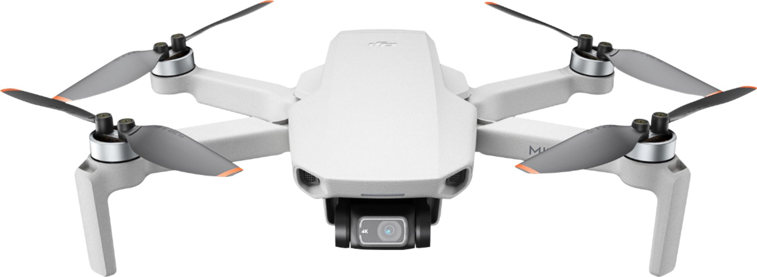

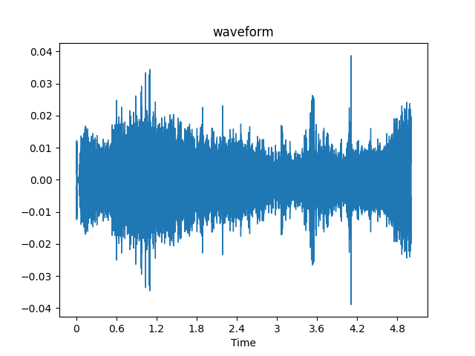
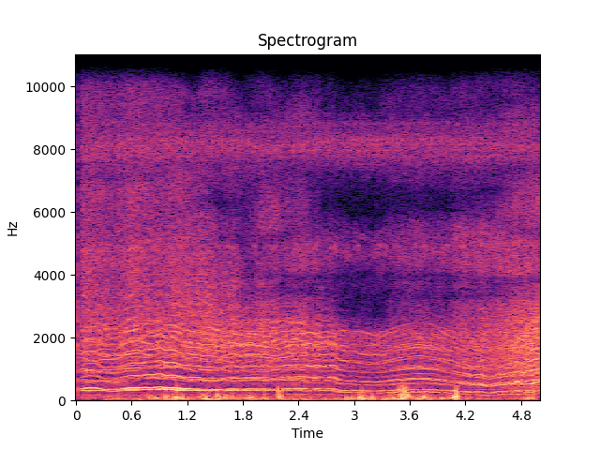
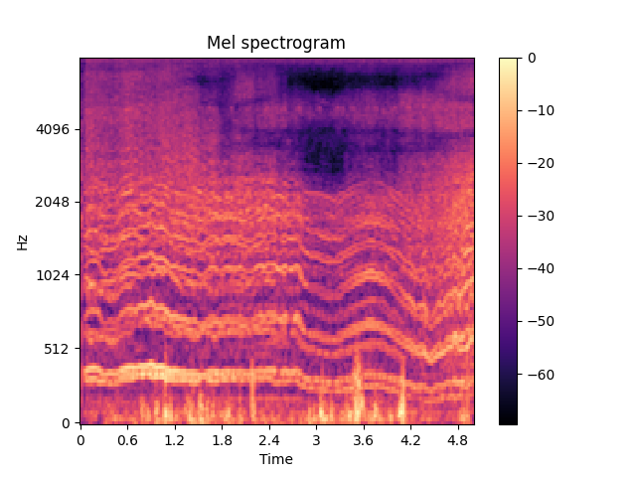
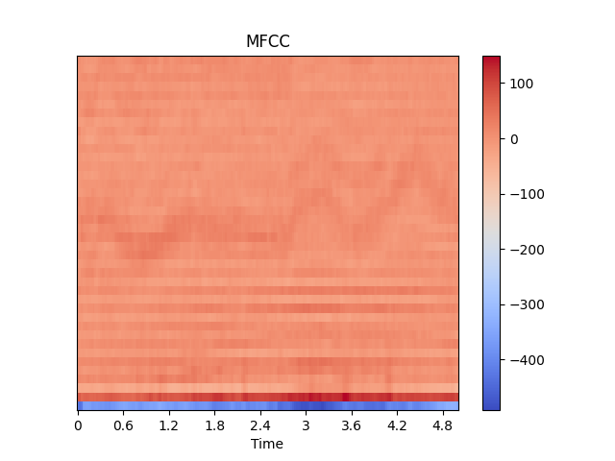
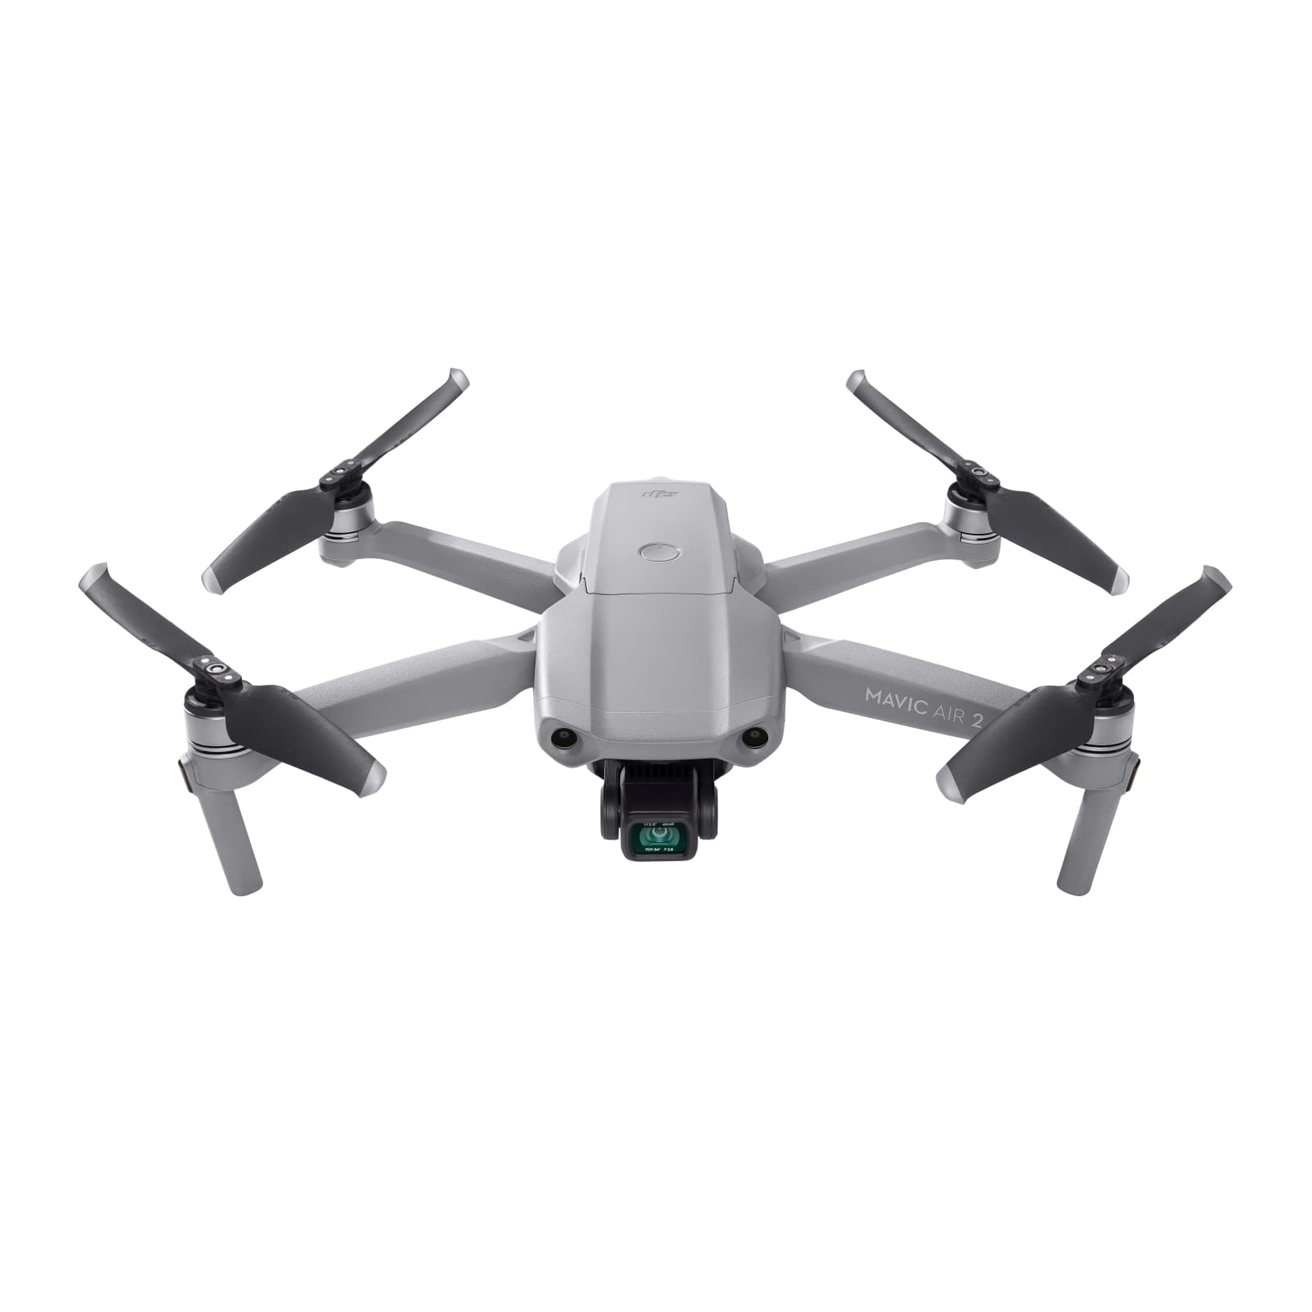
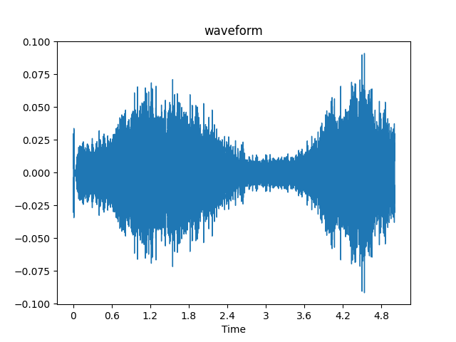
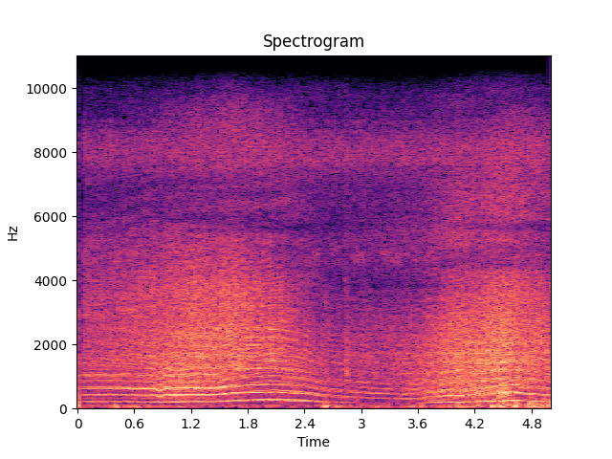
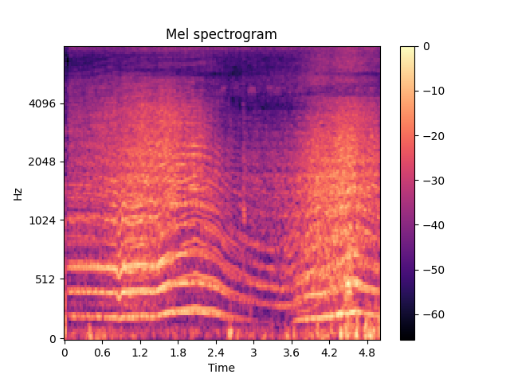
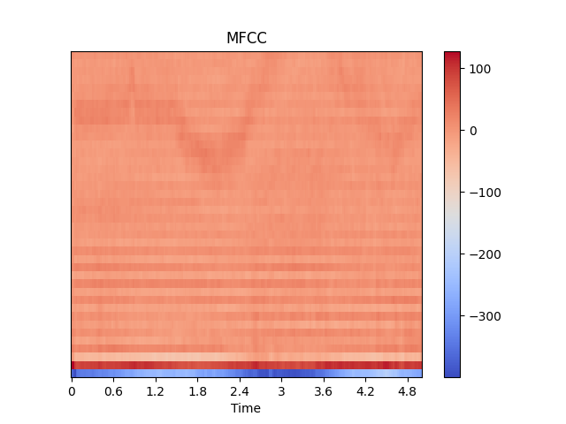
Audio Feature Plot
DJI Mini 2
DJI Mavic Air 2
Notes:
Similar to common practice in audio-based ML, instead feeding a whole audio dataset to ML models, I use the compact representation of the audio signal, instead of the raw audio files. With that, the proposed system reduces the form of feature representation in both size and dimensions of the audio data.
In this research, MFCCs are chosen (mel frequency cepstral coefficients) as the feature extraction method. MFCC is one of the most widely used feature in audio processing applications

Slide 17
Choice of Neural Network
Feed-forward Neural Networks
Convolutional Neural Networks (CNNs)
Multi-Layer Perceptron (MLP)
Recurrent Neural Networks (RNNs)
Notes:
Frequently used neural networks include, but are not limited to, feed-forward neural networks, Convolutional Neural Networks (CNNs), Multi-Layer Perceptron (MLP), and Recurrent Neural Networks (RNNs).
Among these models, this study uses CNN to perform experiments. CNN is a feed-forward network that contains convolution layers and specifically designed to process data with grid-like topologies in images.
In current and previous studies, along with the use of computer vision techniques, CNN produces some of the best results in the image processing areas, such as object detection, image classification, image segmentation, and etc.
Recent works in the audio area proves that CNNs are also effective with audio data. CNNs have been used in different audio-related tasks including audio classification.

Slide 18
Experiments

Slide 19
Three Phases
First Phase
10 classes
Second Phase
15 classes
Final Phase
20+ classes
Notes:
MacBook Air
CNN and KNN are used test audio sample length
5s is chosen

Slide 20
Data collection
A MacBook Air is used to record all audio data
1.1GHz Quad-Core Intel Core i5 CPU and 8GB of memory
Initially, I collected audio samples with different duration.
Two ML models are trained to test which length is better.
Data collection is continued with a length of 5s for each audio file
3s, 5s, and 10s
CNN and KNN
Notes:
MacBook Air
CNN and KNN are used test audio sample length
5s is chosen

Slide 21
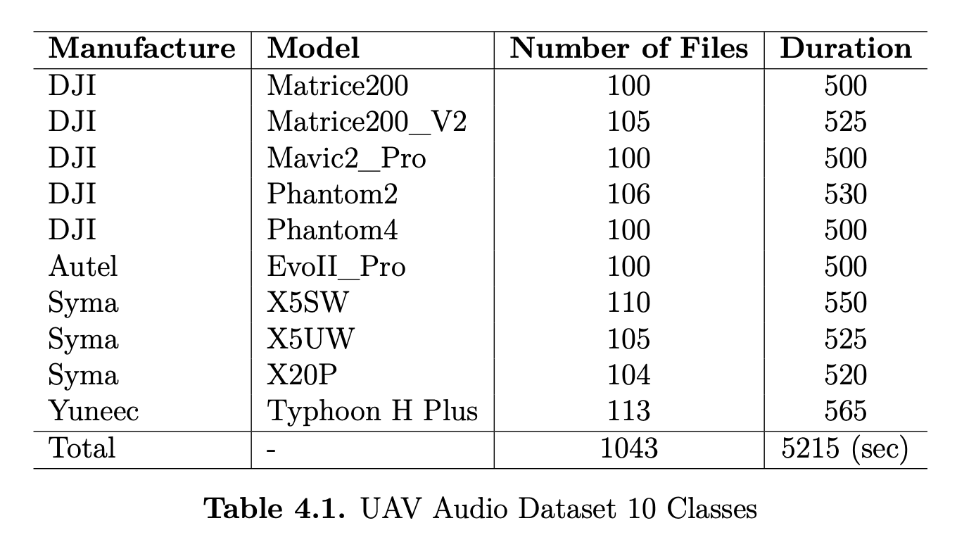
Audio Dataset 10 Classes

Slide 22
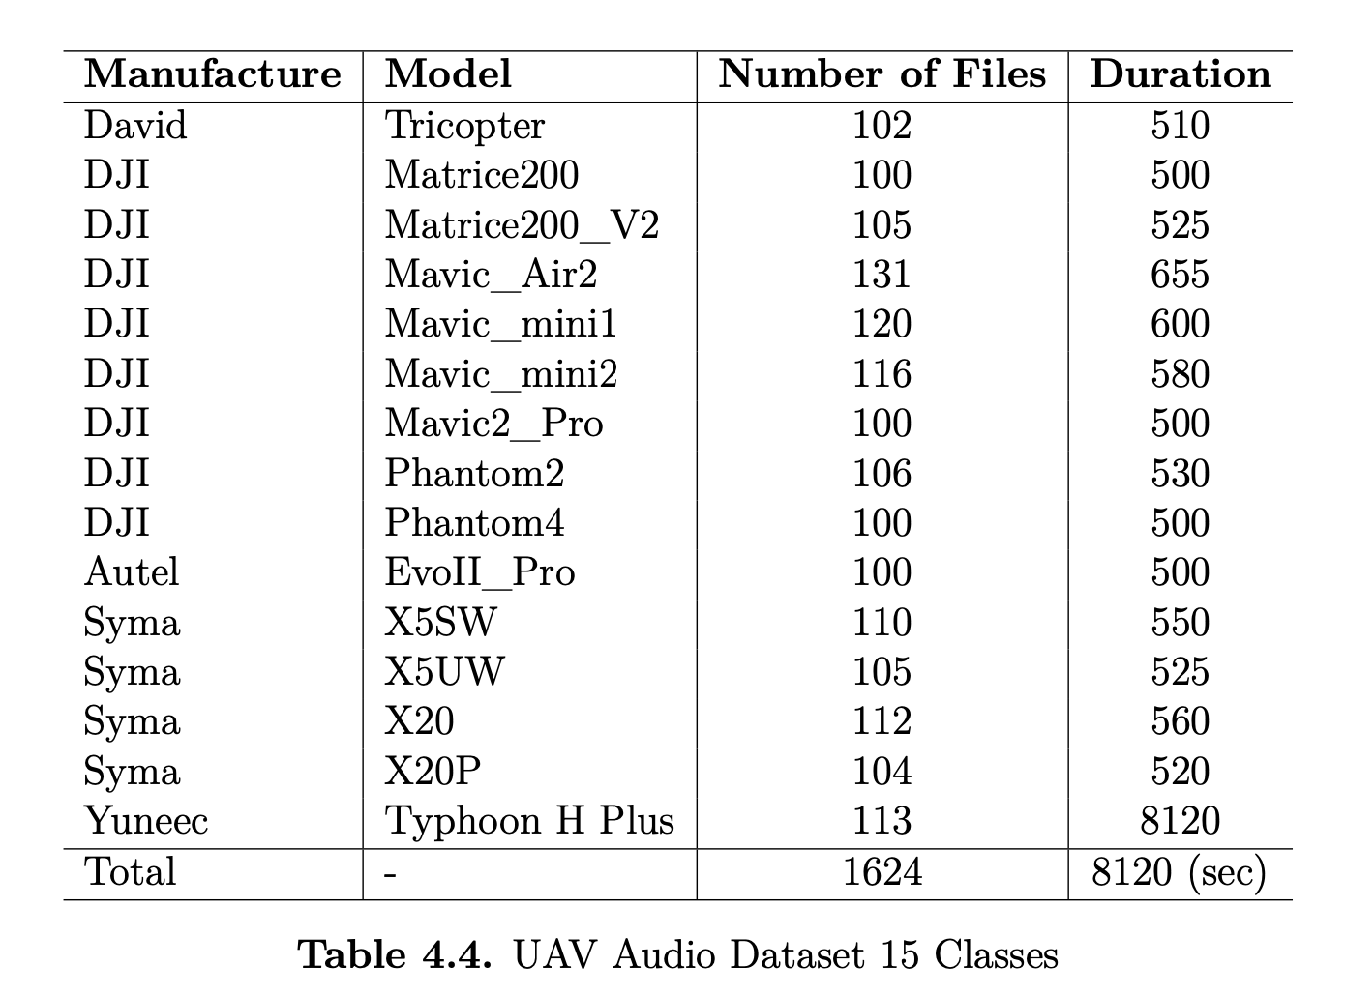
Audio Dataset 15 Classes
Notes:
3 more DJI drones are recorded outside in the same farm as the rest of the drones, 1 Syma drone is recorded in K-SW at Purdue University, and a tricopter built by a friend of mine is recorded in Columbus, IN.

Slide 23
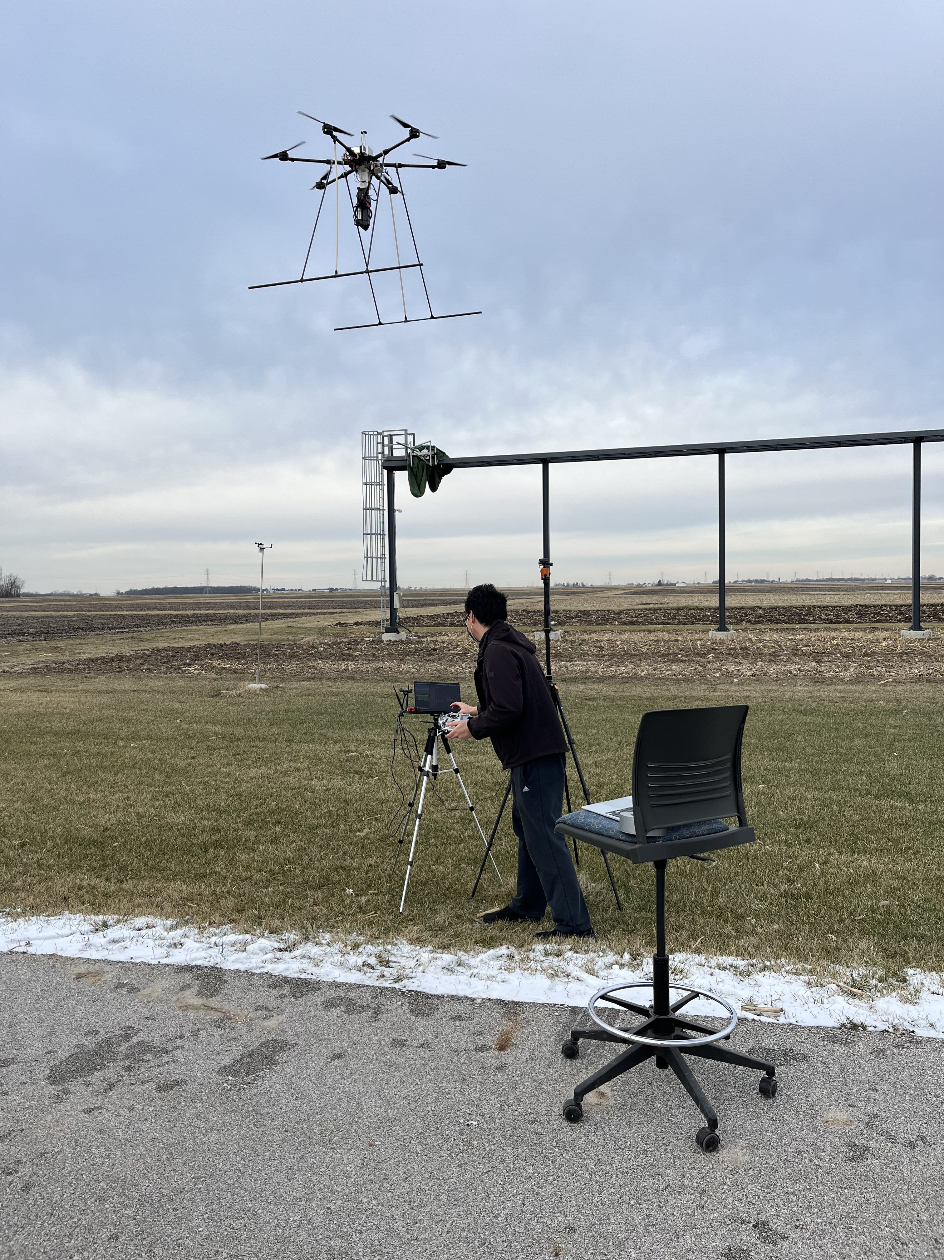
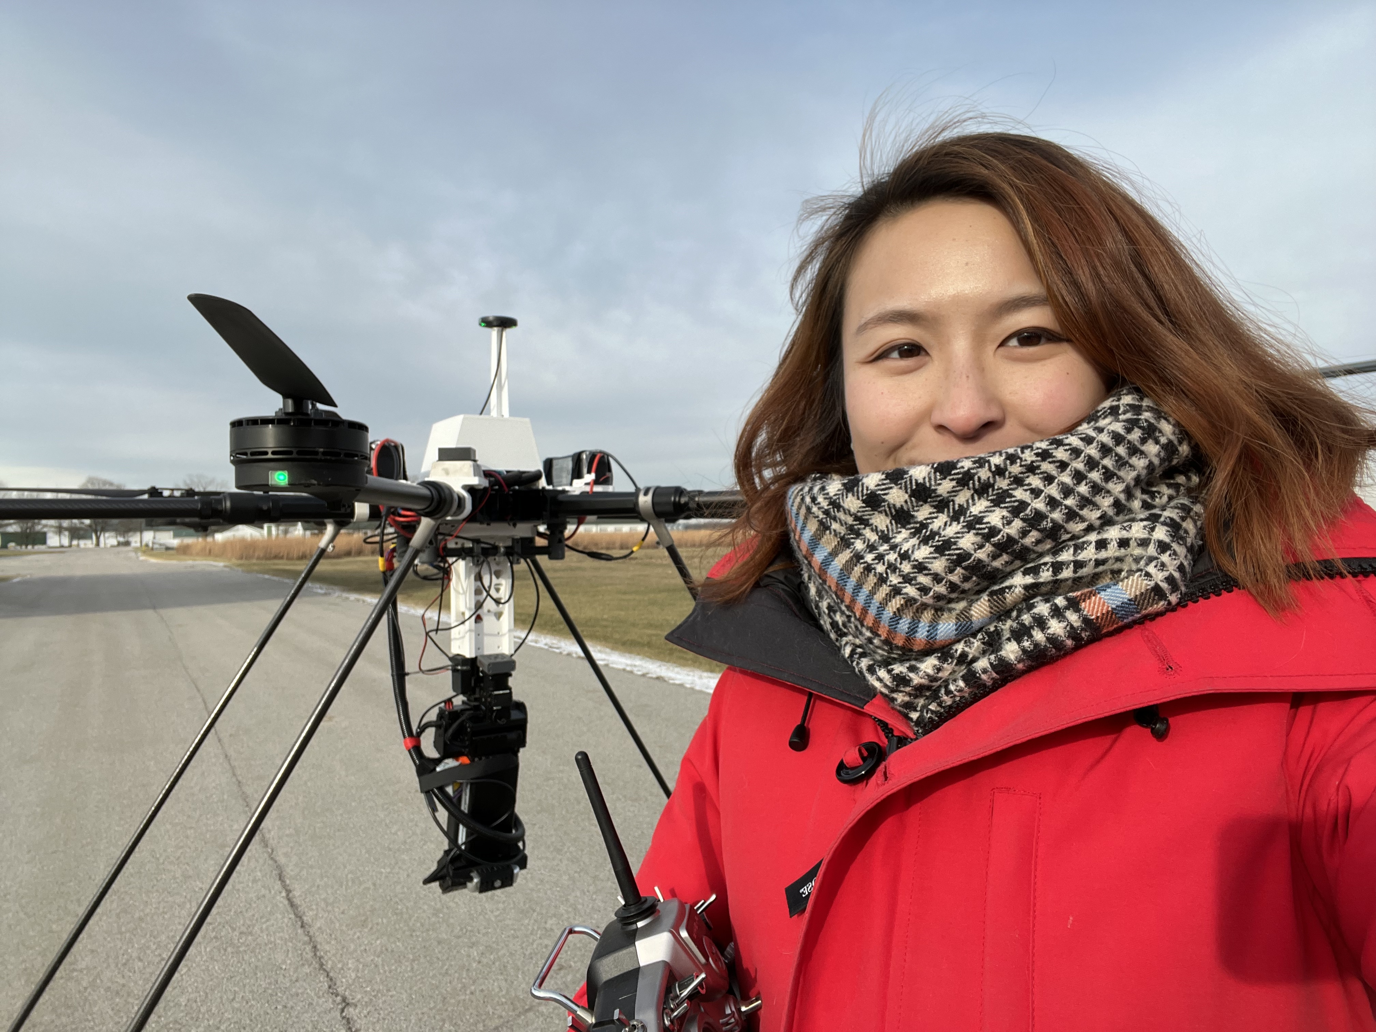
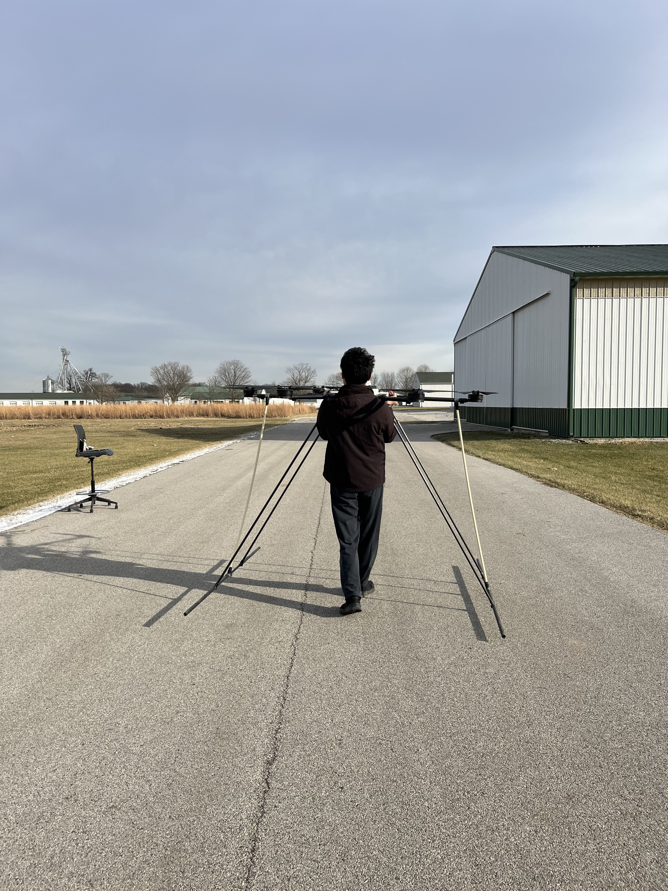
Phenobee
Notes:
3 more DJI drones are recorded outside in the same farm as the rest of the drones, 1 Syma drone is recorded in K-SW at Purdue University, and a tricopter built by a friend of mine is recorded in Columbus, IN.

Slide 24
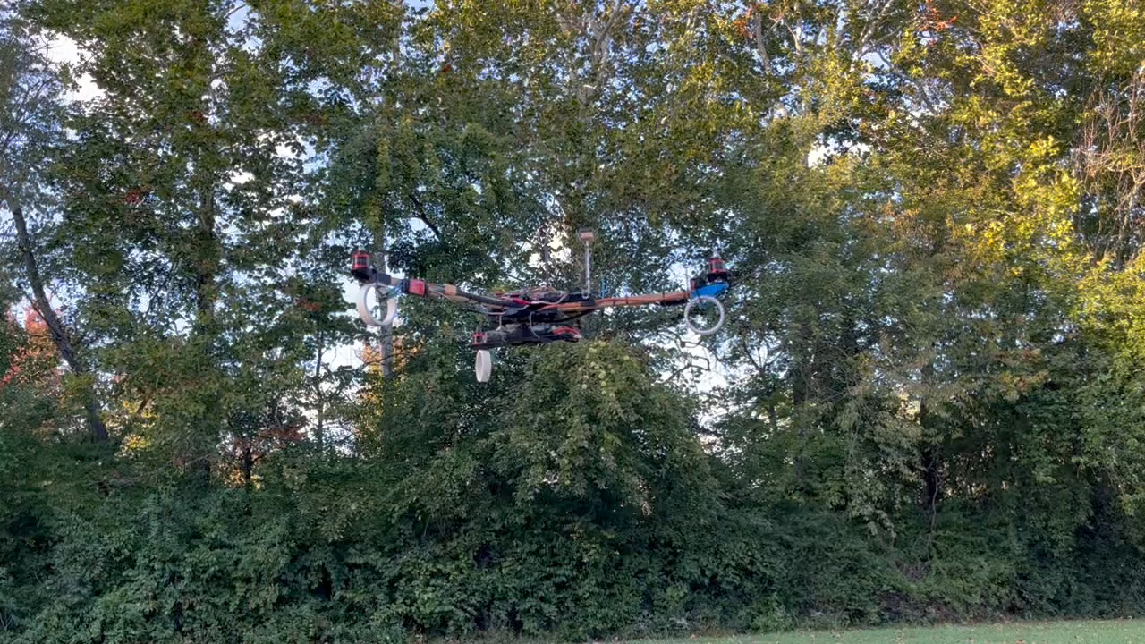
David Tricopter
Notes:
3 more DJI drones are recorded outside in the same farm as the rest of the drones, 1 Syma drone is recorded in K-SW at Purdue University, and a tricopter built by a friend of mine is recorded in Columbus, IN.

Slide 25
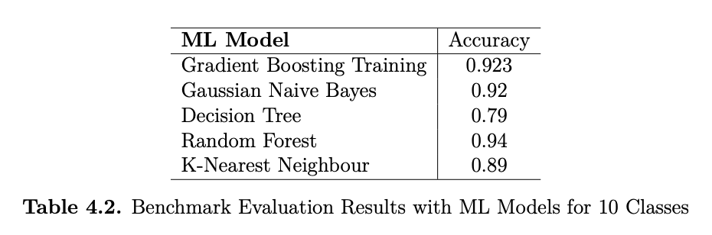
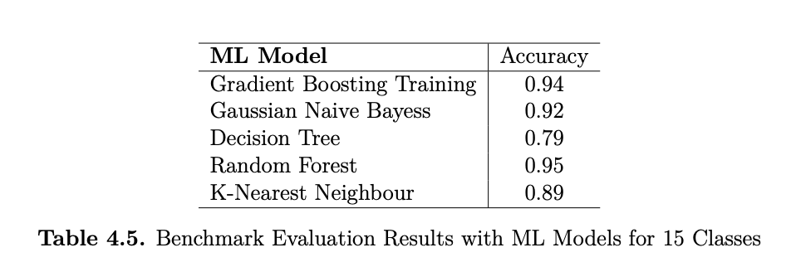
Dataset Evaluation
Notes:
Table here shows the accuracy score from each model.
The dataset is split into 75\% training and 25\% testing. For KNN, I choose 3 as the K value in training. I only use the default values for hyperparameters for all the other ML models.
Three out of five models achieve the accuracy scores above 90\%. Among them, Random forest produces the highest accuracy of 94\%. Decision Tress has the lowest of 79\%.
These results provide a baseline for how well the ML model performs, which is trained with the benchmark dataset.

Slide 26
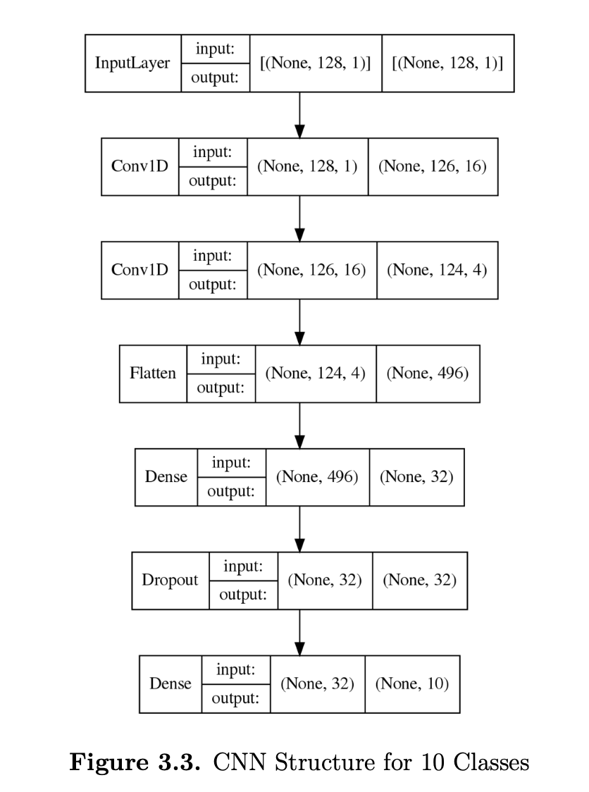
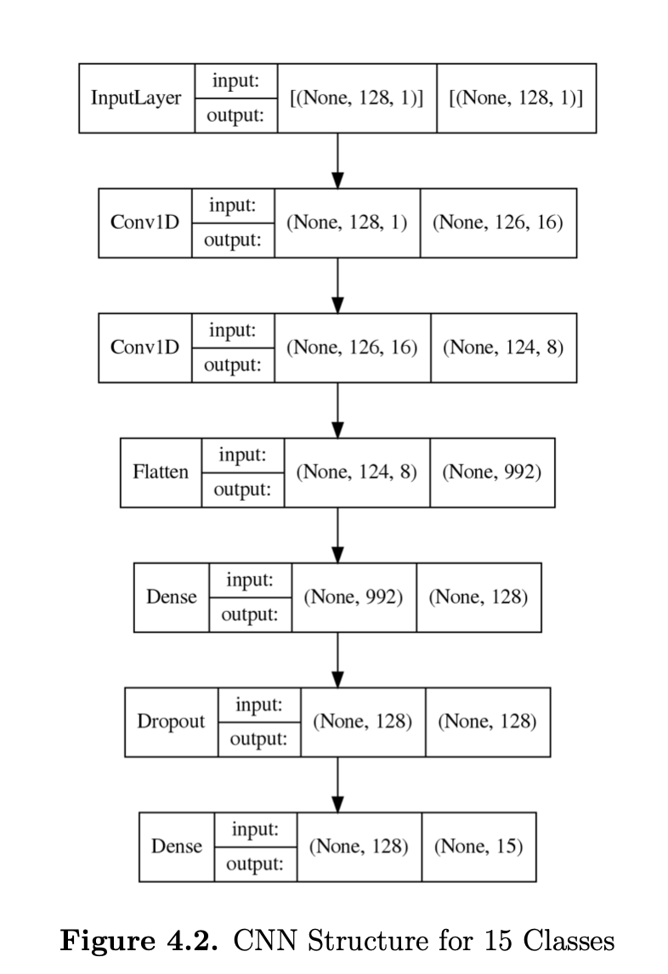
CNN Structure
Notes:
To train the proposed CNN model, as shown in Figures here.
the dataset is split into training and testing sets. 75\% data are included in the training set while the rest 25\% data are used for testing.
I choose Adam as the optimizer in training and the learning rate is set to 0.001. Categorical cross-entropy is selected the loss function and the model is trained with batch size 32.
The model is trained on a server with an Intel Core i7-5930K CPU, 64GB of memory, and an Nvidia GeForce RTX 2070 Super 8GB GPU. The server is installed with Tensorflow version 2.8.0 combined with Python 3.8.14 as the framework to implement the CNN model.

Slide 27
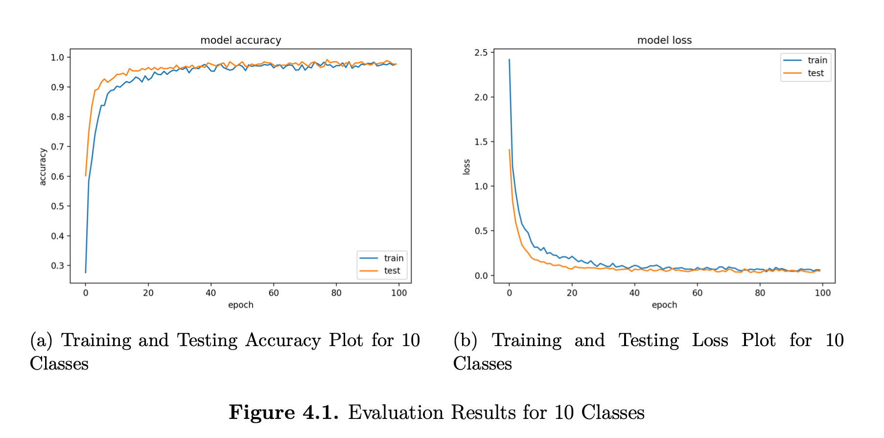
CNN Training
Notes:
The model is trained for 100 epochs and the average training time using the above configuration is 17.31 seconds with a standard deviation of 0.44 seconds.
This result is collected from 10 i.i.d model training runs. The model accuracy history and loss history plots are shown in Figures above. In both plots, the line shown in blue is the training accuracy and loss history, and the yellow line shows the test accuracy and loss history.
As shown in the history plots, the model converges after epoch 60 since the accuracy is not increasing as well as the loss is not decreasing as the training continues. Also, we can see from the plots that the accuracy and loss of the training dataset and testing dataset are not parting away from each other after the model saturates.
Therefore, no overfitting nor underfitting is happening when trained the model with 100 epochs.

Slide 28
Model Evaluation and analysis I
The average test accuracy of 10 separate trained model is 97.43\% and the standard deviation is 0.9\%.
The average test loss is 0.085 with a standard deviation of 0.051.
Notes:
I trained the same model 10 times using the proposed dataset and collected the test accuracy and test loss results. The average test accuracy of 10 separate trained model is 97.43\% and the standard deviation is 0.9\%, and the average test loss is 0.085 with a standard deviation of 0.051. The statistics show that the proposed CNN model and the training configuration have a persistent overall performance and can be reproduced for further research.

Slide 29
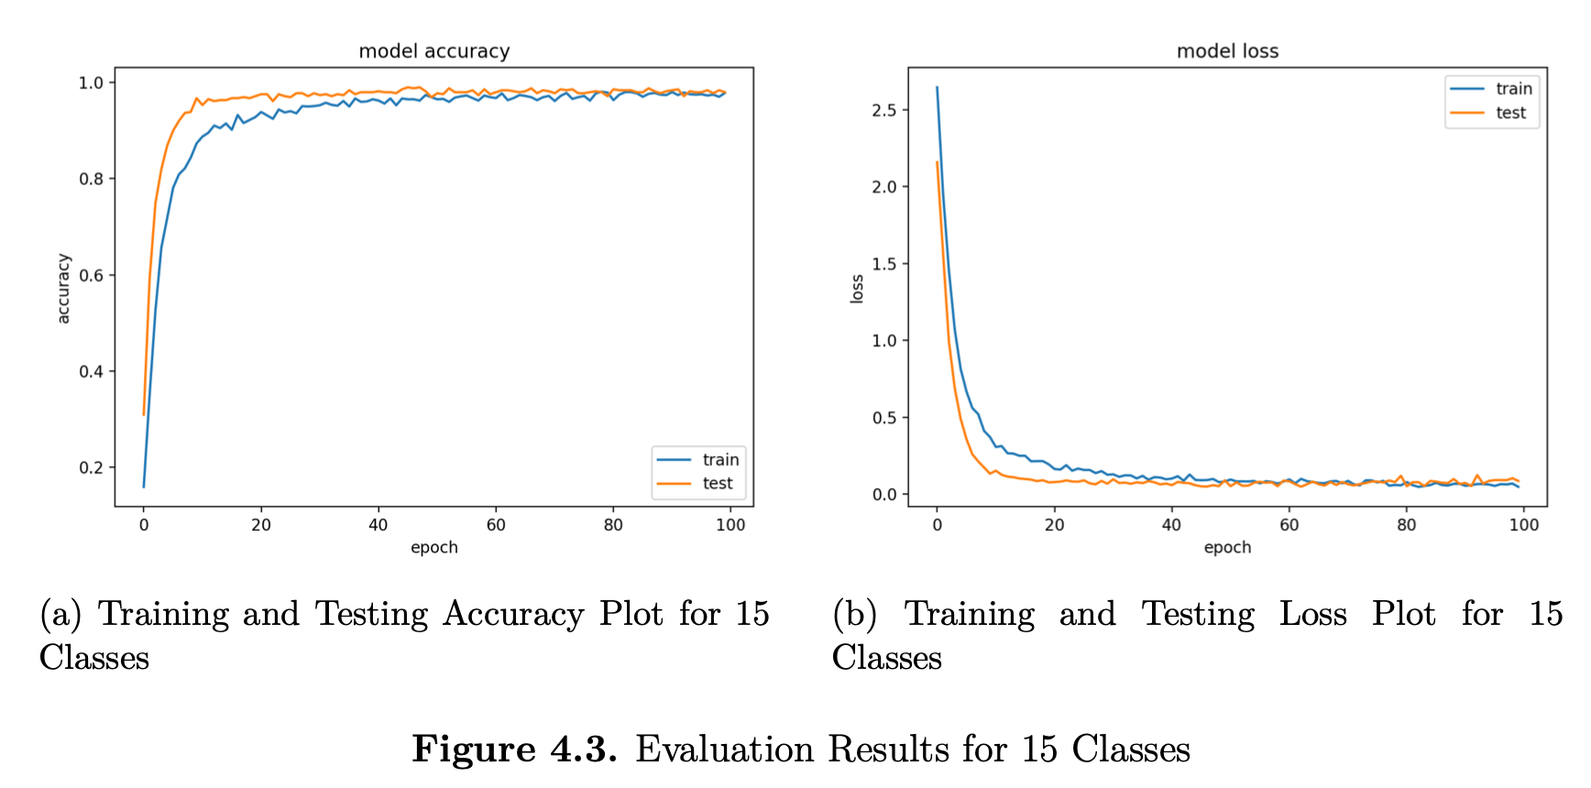
cnn Training II
Notes:
I train the model for 100 epochs and the average training time using the above configuration is 22.39 seconds with a standard deviation of 0.005 seconds.
This result is collected from 10 i.i.d model training runs. The model accuracy history and loss history plots are shown in Figures above.
In both plots, the line shown in blue is the training accuracy and loss history, and the yellow line shows the test accuracy and loss history. As shown in the history plots, the model converges after epoch 40 since the accuracy is not increasing as well as the loss is not decreasing as the training continues. Also, we can see from the plots that the accuracy and loss of the training dataset and testing dataset are not parting away from each other after the model saturates.
Therefore, no overfitting nor underfitting is happening when trained the model with 100 epochs.

Slide 30
Model Evaluation and analysis II
The average test accuracy of 10 separate trained model is 98.2% and the standard deviation is 0.5%.
The average test loss is 0.088 with a standard deviation of 0.022.
Notes:
I trained the same model 10 times using the proposed dataset and collected the test accuracy and test loss results. The average test accuracy of 10 separate trained model is 97.43\% and the standard deviation is 0.9\%, and the average test loss is 0.085 with a standard deviation of 0.051. The statistics show that the proposed CNN model and the training configuration have a persistent overall performance and can be reproduced for further research.

Slide 31
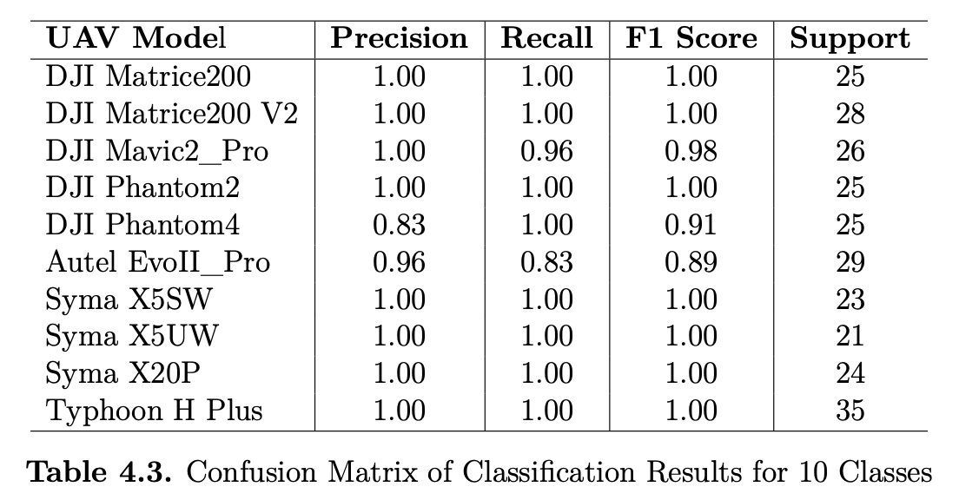
Result Evaluation and analysis I
Notes:
As the table shows, the precision of each type of UAV's classification result is above 83\%, from which 8 UAV models' classification results reach a precision score of 100\%. Furthermore, all recall values are also above 83\% with 8 of them equal to 100\%. The high precision values and high recall values indicate the model is a good classifier where not only does the model's classification result have a low number of false positives, but also has a low false negative rate. What's more, the calculated F1 scores further prove that the proposed CNN model has great performance when classifying UAVs using audio data.

Slide 32
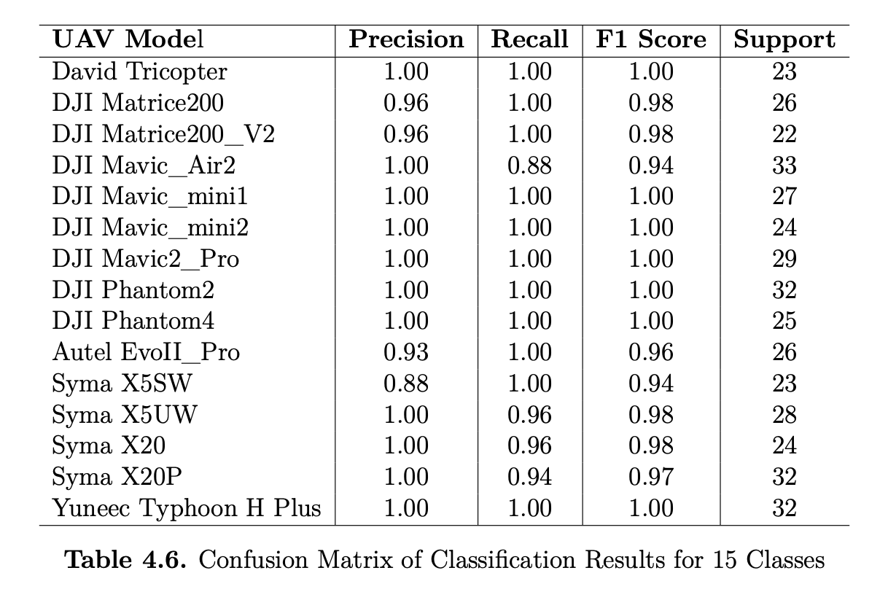
Results Evaluation and analysis II
Notes:
Table here illustrates the calculated number of each score and the number of recordings used for all UAVs. We can see that the precision of each type of UAV's classification is above 89\%, with 11 of them achieved 100\%. In addition, all the recall scores are above 88\%, and also 11 of them are 100\%. Again, similar to the first stage experiment, the high precision values and high recall values indicate our model is a good classifier where not only does the model's classification results have a low number of false positives and false negatives. Furthermore, the calculated F1 scores indicates that that the proposed CNN model has great performance when classifying UAVs using audio data.
The overall test accuracy of the trained model is 98.7\% and the test loss is 0.076. I train the same model 10 times using the proposed dataset. The average test accuracy of 10 separate trained model is 98.2\% and the standard deviation is 0.9\%, and the average test loss is 0.085 with a standard deviation of 0.0052. The statistics indicates that the proposed CNN model and the training configuration have a persistent overall performance and can be reproduced for further research.

Slide 33
future works

Slide 34
Future works
Phase III
Dataset Collection
Dataset Evaluation
CNN Training
Results Evaluation and Analysis

Slide 35
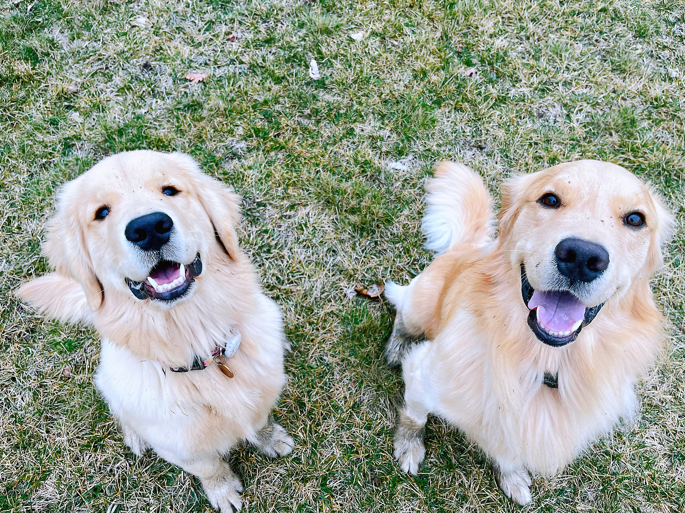
THANK YOU!

